Slide 1

Story of milk Urszula Kudla PhD; World Expo Osaka; 11 June 2025
【牛奶的故事 乌尔苏拉·库德拉博士；大阪世博会；2025年6月11日】

Slide 2
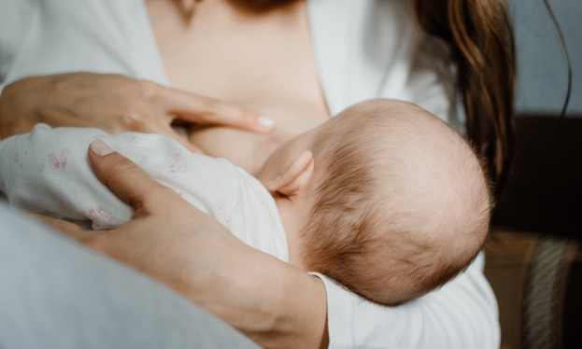
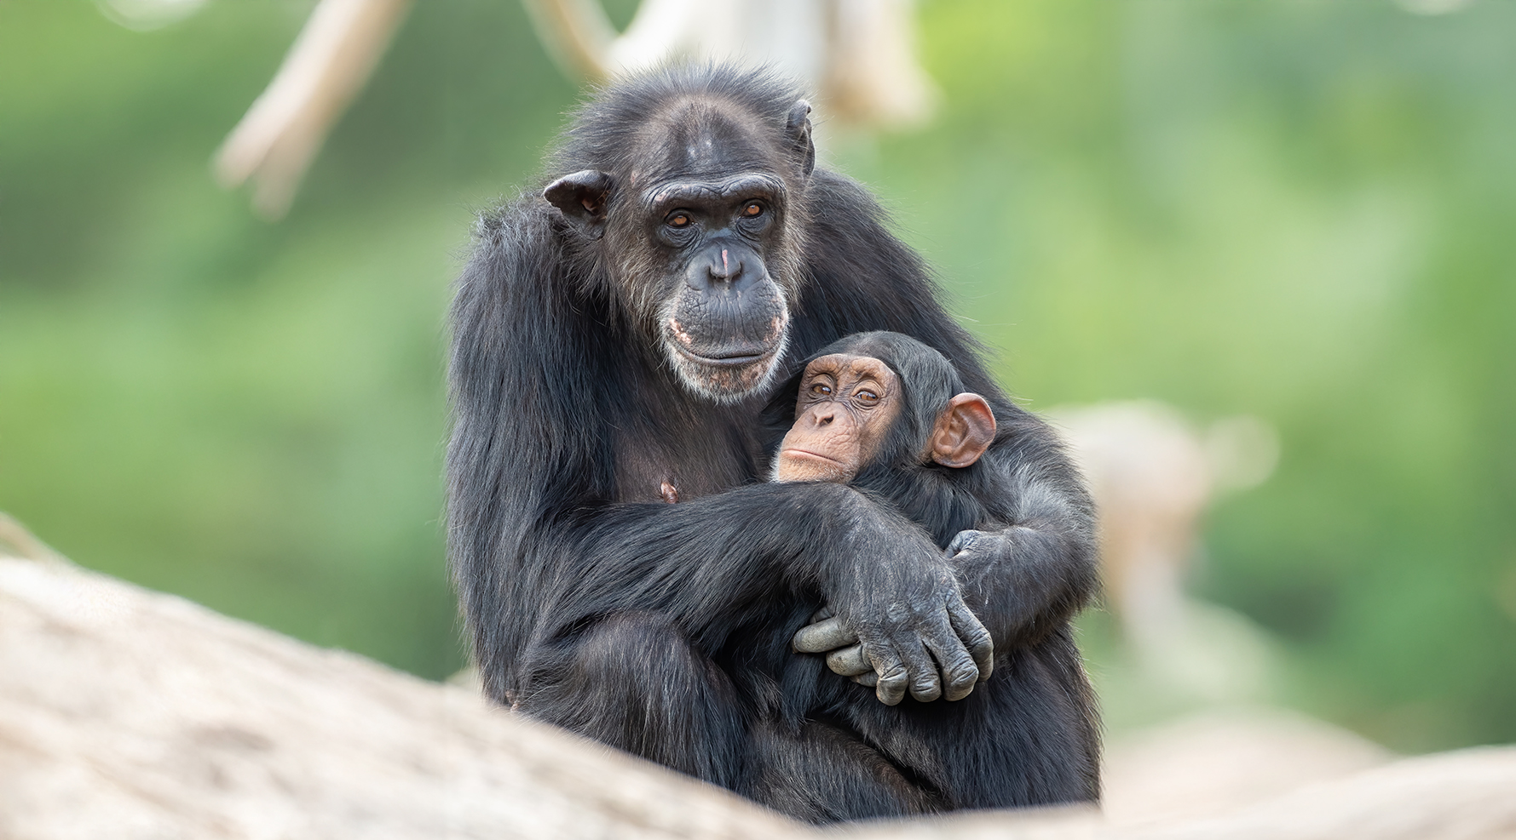
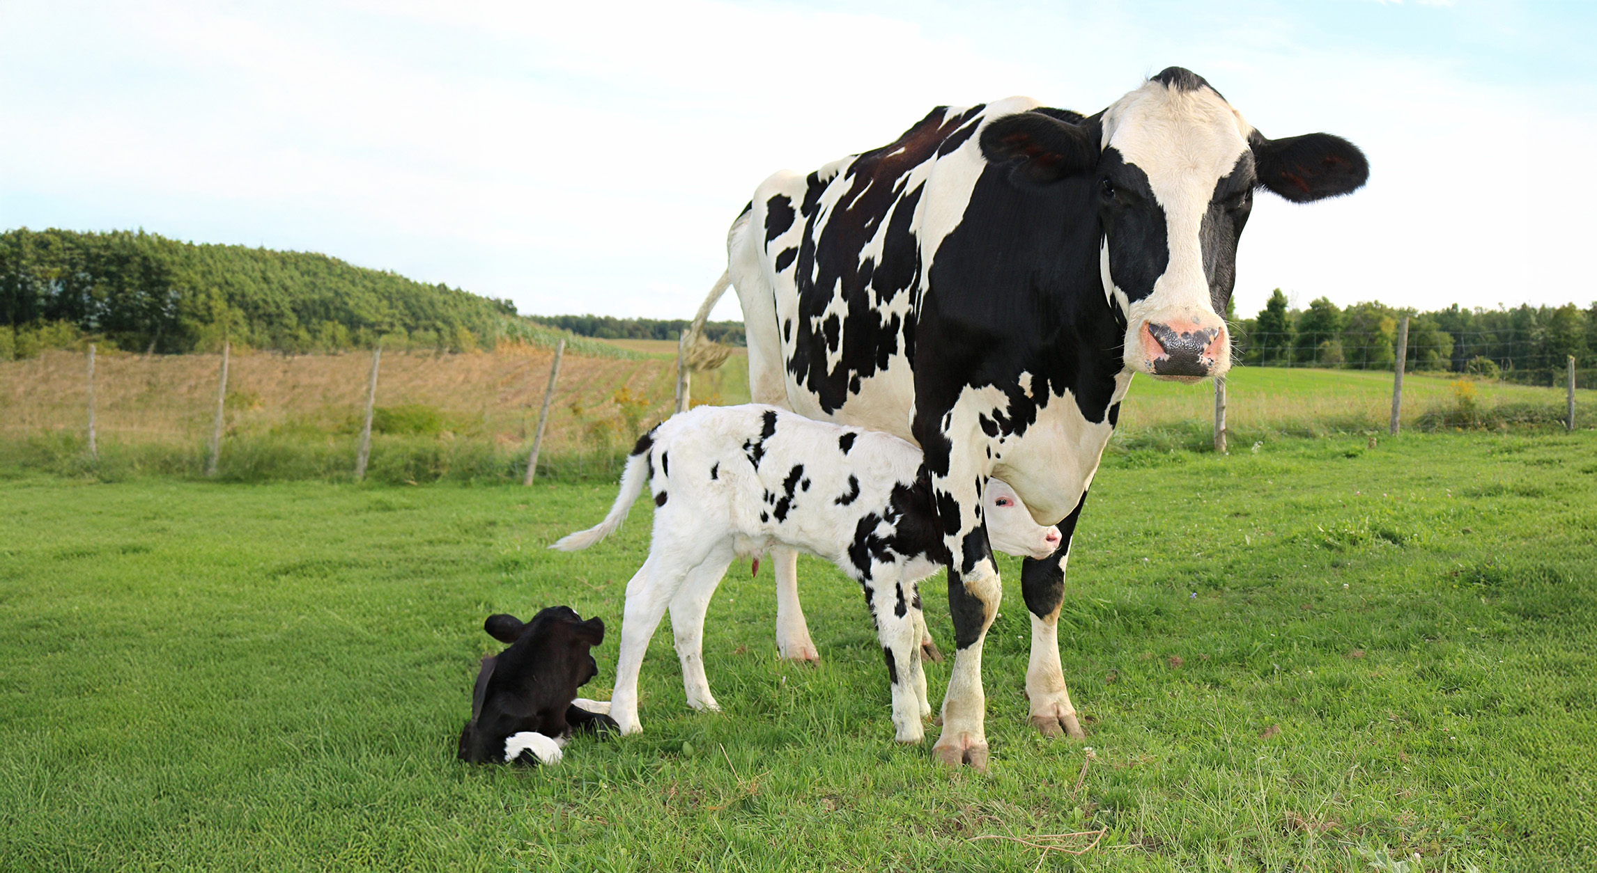


Milk is the ultimate food for all mamals
Lactation Through evolutionary experimentation, mammals have spent the last 120 milion years successfully developing ‘ the most efficient, effective and adaptable means of postnatal nutrient provision that has even arisen amnong vertebrates-lactation.’
.
DG Blackburn DG 1993, University of California, Davis

Slide 3
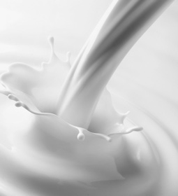
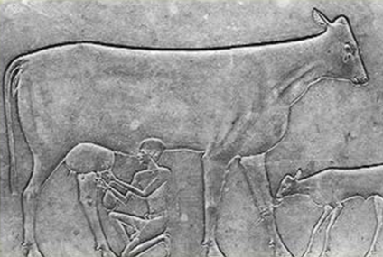
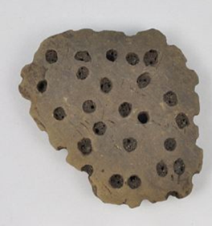
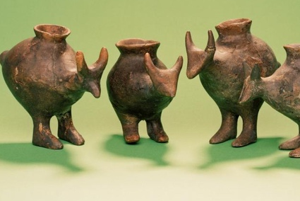
Milk in human history
.
~7500
~6000
Ability to digest lactose in adulthood emerged around (in Europe & Africa)^{1,2}
Egypt
XIth Dynasty Temple, the sarcophagus of Kawit
The survival advantage it offered, made it one of the most strongly selected trait in in last 20 000 years ^{1,2}
Sieve used to make cheese
Prehistoric baby bottles
~7000
~5000
1.Bersaglieri T, 2004 Jun;74(6):1111-20; 2 Tishkoff SA, 2007 Jan;39(1):31-40.
..
Notes:
1.From central Europe
2. a scene on the sarcophagus of Kawit, XIth Dynasty Temple
3. from Germany
European and African genomes

Slide 4
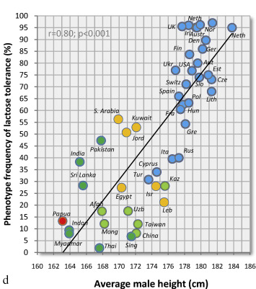
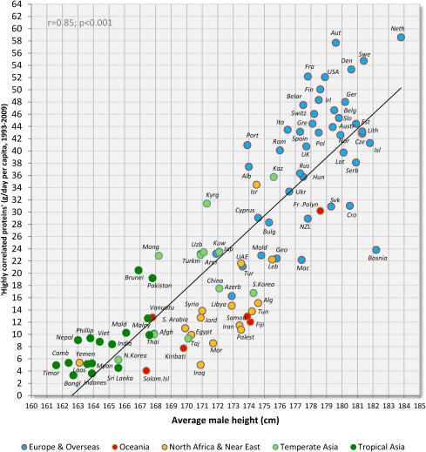

The benefits of dairy (protein) consumption seem to continue till this day
The correlation between: PROTEINS & MALE HEIGHT
The correlation between: LACTOSE TOREANCE & MALE HEIGHT
Highly correlated proteins (g/day per capita, 1993-2009)
Phenotype frequency of lactose tolerance (%)
Daily consumption of proteins from milk products (dairy), potatoes, eggs, pork and beef
.
Average male height (cm)
Average male height (cm)
Grasgruber et al. 2016

Slide 5


Component | # Components
Water Fat Lactose Protein Salts Acids Oligo’s Others | 1 >10.000 1 >1000 >100 10 >20 >100
Dry matter
4,51%
Protein
13%
Dry matter
Minerals 0,47
Other 0,48
Vitamins
0,002
4,37%
Fat
3,52%
Protein
87%
Water
.
Cow Milk composition
Walstra, Wouters and Geurts (2005) https://doi.org/10.1201/9781420028010

Slide 6
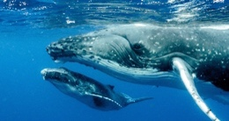
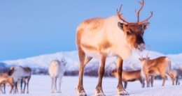


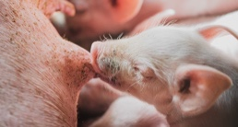
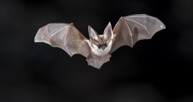

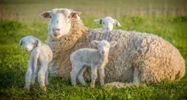

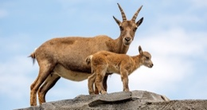

Milk is a very adaptable, dynamic source of nutrition.
Blue whale | Fat | Protein | Lactose
 | 42 | 10.4 | 1.3 | Reindeer
Armadillo | 18 | 10.5 | 2.6
 | 7.6 | 11.1 | 2.3 | Horse
Pig | 1.7 | 2.5 | 6.0
 | 6.5 | 5.7 | 5 | Bat
Scheep | 13 | 7 | 3
 | 7.5 | 5.6 | 4.6 | Buffalo
Goat | 7.5 | 4.5 | 4.8
 | 4.5 | 3.6 | 4.3 | Cow
Human | 4.4 | 3.5 | 4.6
 | 3.8 | 1.2 | 7.0
.

Slide 7
Milk is (almost) a complete nutrition, also when it comes to micronutrients
Minerals | mg/100 gram | Relevant*
Potassium (K) | 150
Chloride (Cl) | 95
Calcium (Ca) | 120
Phosphorus (P) | 95
Magnesium (Mg) | 11
Iron (Fe) | 0.06
Zinc (Zn) | 0.37
Copper (Cu) | 0.005
Manganese (Mn) | 0.003
Iodine (I) | 0.015
Selenium (Se) | 0.0022
Cobalt (Co) | 0.00005
Molybdenum (Mo) | 0.004
Vitamines | mg/100gr | Relevant
B1 (thiamin) | 0.0365
B2 (riboflavin) | 0.185
B3 (niacin) | 0.11
B5 (panthotenic acid) | 0.362
B6 (pyridoxine) | 0.041
B9/B11 (folic acid) | 0.007
B12 (cobalamin) | 0.00044
B7/8 (Biotin) | 0.0027
C (ascorbic acid) | 1
A (mg) | 0.04445
D | 0.00005
E (tocopherol) | 0.11
K (phylloquinone) | 0.00229
.
*Relevant≠claimable (red = <1%RDA/100gr)
Walstra, Wouters and Geurts (2005) https://doi.org/10.1201/9781420028010

Slide 8



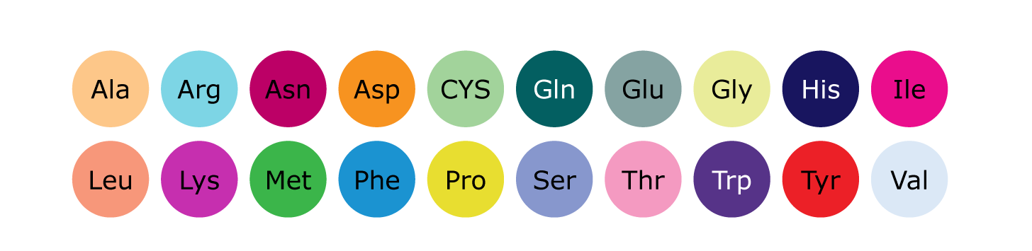
Protein is a very important macronutrients as it provides building blocks for our bodies
.
5%
Carbohydrates & other
Proteins consist of chains of several hundreds or more amino acids
15%
9 amino acids cannot be synthesized by the human body
Essential amino acids can only be supplied via food
Fat
20%
Protein
There are 20 different amino acids in human body
60%
Water

Slide 9
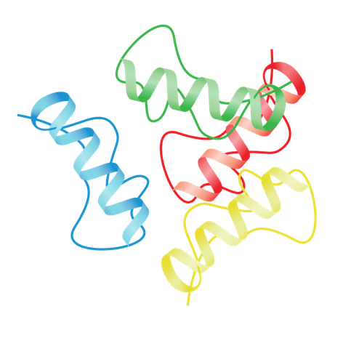





Amino acids, the building blocks of all proteins, are fundamental for optimal physiological function
Protein
Polypeptide
Functions of amino acids¹
Protein synthesis
Regulatory and catalytic functions
Signaling functions
.
Immune functions
Amino Acids
Source of energy
1. Wu G. Amino Acids 2009;37:1–17; 2. Lopez MJ and Mohiuddin SS. Biochemistry, Essential Amino Acids.
Amino acids
Functions of amino acids¹
Protein synthesis
Regulatory and catalytic functions
Signaling functions
Immune functions
Source of energy

Slide 10
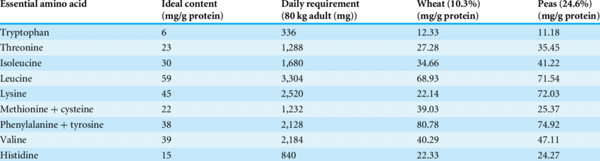
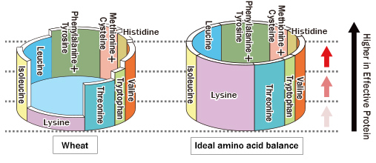
Not all proteins are balanced in their essential amino acid composition
Many proteins are deficient in one or more amino acids and thus cannot be efficiently utilized by the body
Notes:
Limited utilization by the human body
Further limitations due to low digestibility

Slide 11
Protein quality differs significantly between foods
.
Protein quality score
Take into account amino acid composition and digestibility
Reference to ‘ideal protein’
Determined by the first limiting amino acid
Ref

Slide 12
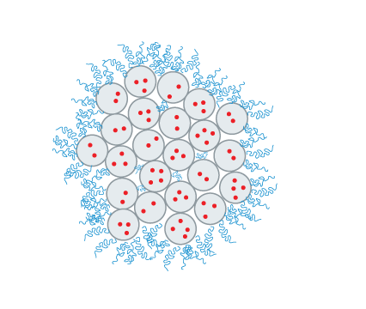
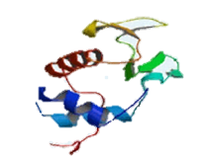

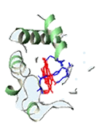


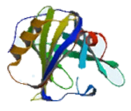
Milk protein contains 2 distinct types of protein: casein and whey
Casein Micelles | non-globular structure
Whey Proteins | globular structure
α-Lactalbumin
κ-casein
Submicelle:
α_{s1}-, α_{s2}-,β-casein
Bovine Serum Alumini
Calcium phosphate nanocluster
β-Lactoglobulin
Heat stable and acid sensitive
Heat sensitive and acid stable
<编号>
Walstra, Wouters and Geurts (2005) https://doi.org/10.1201/9781420028010
Notes:
Casein: Relatively large particles associates of casein molecules
Heat stable
Acid sensitive
Whey: Present in milk as monomers
Heat sensitive
Acid stable

Slide 13


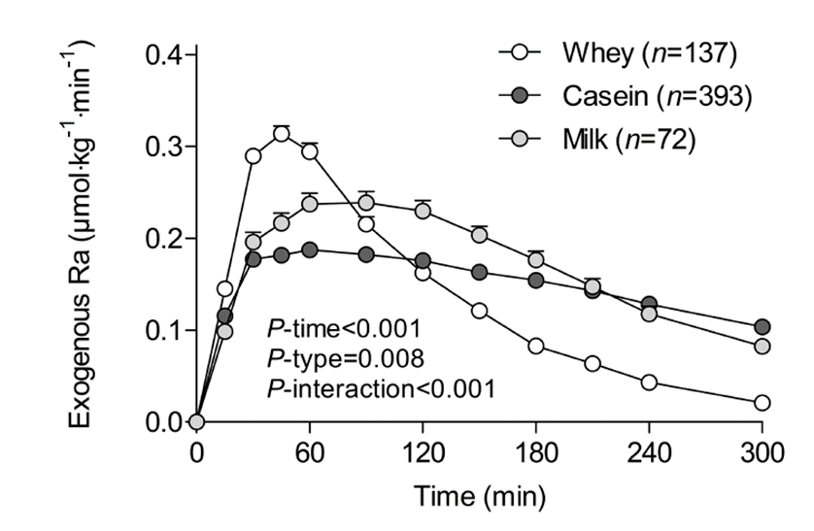
Milk proteins are also digested differently and therefore possibly serve different biological functions
.
Speed of Amino Acid appearance in blood after consumption of different proteins¹
Gorrisen et al. 2020
Notes:
Whey is faster to digest and has higher Leucine content = kick starts muscle protein synthesis
Casein is slower to be digested and provides more steady supply of amino acids and also minerals like calcium

Slide 14





Beyond nutrition: bioactive components of milk
Milk contains many bioactive components which serve function other than providing building blocks and energy
Immune modulation & antimicrobial activity
Digestive function
Gut development
Cognitive development
Carriers for other nutritents
.
Lactoferrin1 ¹
Secretory IgAs ²
IgGs ³
Osteopontin ⁴
Lactoperoxidase ⁵
HMOs ⁶
….
Bile salt-stimulated lipase ⁷
Amylase ⁸
A1-antitrypsin ⁹
HMOs ¹⁰
….
Growth factors ¹¹
Lactoferrin ¹²
Nucleotides ¹³
….
PUFAs ¹⁴
MFGM ¹⁵
Sialic acid ¹⁶
Choline ¹⁷
HMOs ¹⁸
…..
Lactoferrin ¹⁹
B-casein ²⁰
Folate binding protein ²¹
…
1.Berthon et al 2022; 2.Donald et al 2022, 3.Ulfman et al 2018, 4.Jiang et al 2020; 5. Flemming et al 2016; 6. Ballard. 2013 ; 7. Lindquist et al 2010; 8. Hamosh et al 1996; 9. Davidson et al 1990; 10. Walsh et al 2020; 11. Oguchi et al 1997; 12. Carr et al 2021; 13. Qu et all 2023; 14.Lassek et al. 2015; 15 Deoni et al 2024; 16. Wang et al 2009; 17.Derbyshire et al 2020; 18.Berger et al 2020; 19. Milkuic et al 2020 20. Sato et al 1986; 21. Wigertz e al 1997 100Peila, C., et al (2024); Kanwar et al 2015

Slide 15


Do bioactive components from cow’s milk work in humans?
.
When milk is gently processed the biological function of milk component is preserved and confers cross species benefits
Diarrhea with fever
Runny noses
Ear infection (Otitis)
Does milk protects against diarrhea with fever?
UHT milk
Pasteurised milk
Farm milk (heated)
Farm milk (raw)
0.2
0.4
0.6
0.8
1
1.2
1.4
1.6
Loss et al 2015

Slide 16
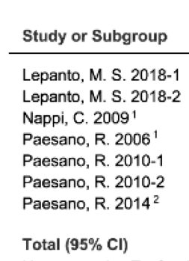
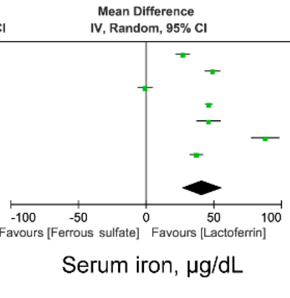
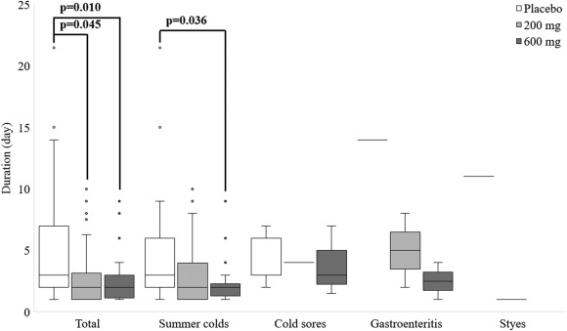
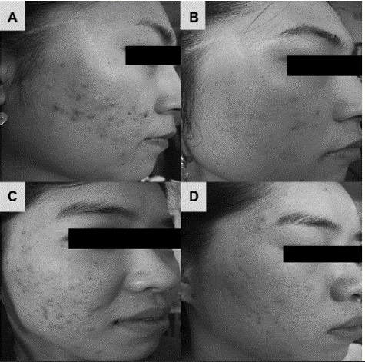
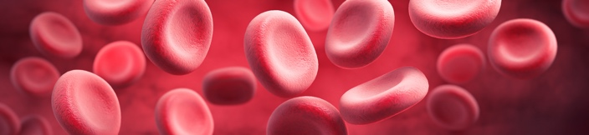

Bioactive milk ingredients continue to provide benefits across different ages and health areas
Anti-inflammatory properties of Lactoferrin can be used in skin care
Lactoferrin as a therapy for treating anemia in pediatrics and adults with almost no adverse effects
Lactoferrin attenuates colds in Japanese adults in summer period
.
Kim et al 2010
https://www.mdpi.com/2072-6643/14/3/543
https://www.sciencedirect.com/science/article/pii/S1684118220300384#fig3

Slide 17
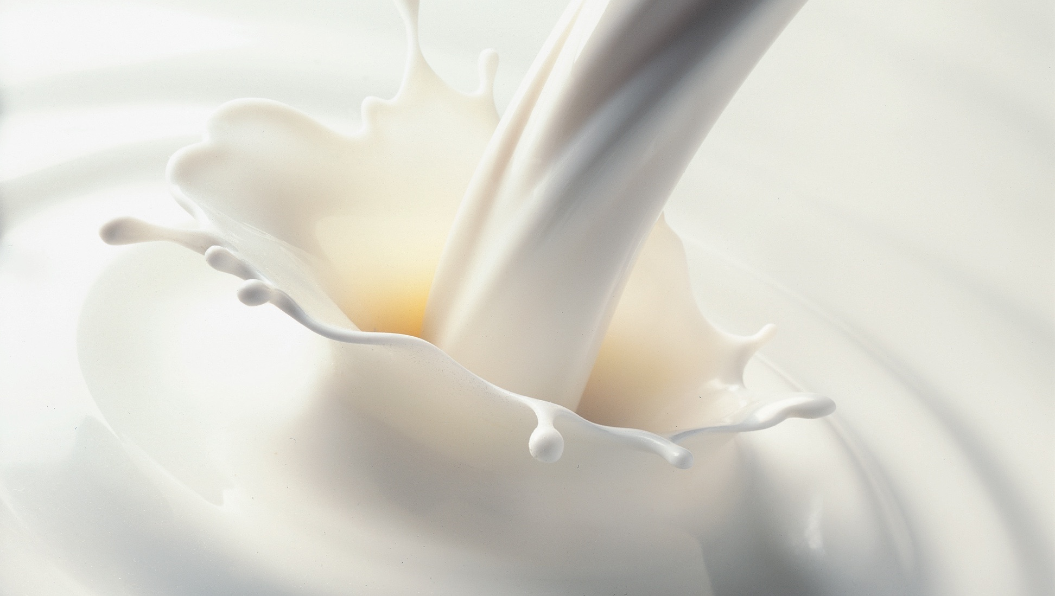
Have we reached the boundaries of milk science?

Slide 18
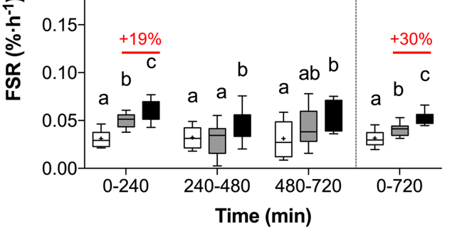
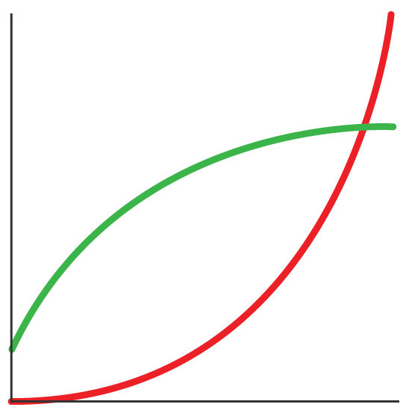
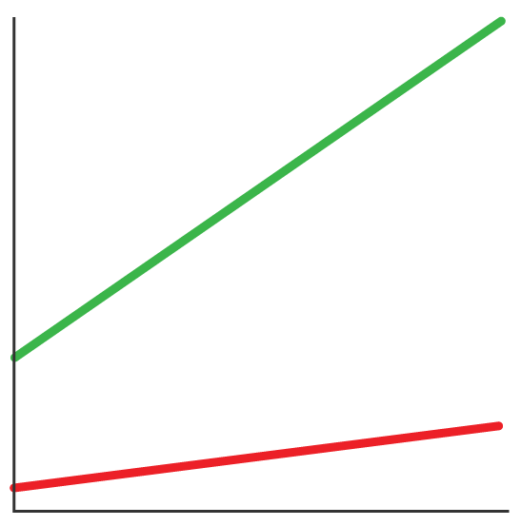
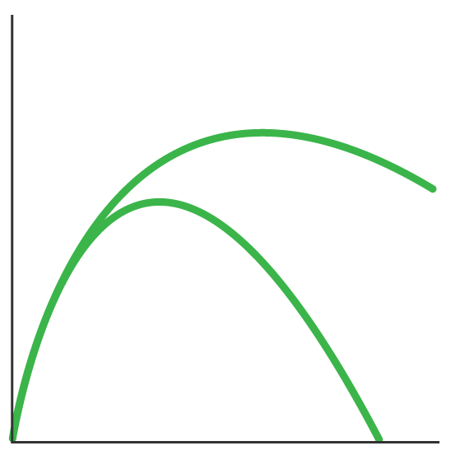
“Ingestion of 100 g protein results in higher muscle protein synthesis levels compared to 25 g protein”
New study shows no upper limits in duration and magnitude of anabolic response to protein
It was thought there was no benefit to ingesting more than 25gr of protein per meal (~every 4 hours)
Prior assumption
New understanding
Anabolism
Time resolution
FSR (% .h⁻¹)
Muscle recovery
Higher dose
Cumulative response
Rate
.
Lower dose
Protein intake
Protein intake
Time
0g protein
25g protein
100g protein
To be continued with new studies …..
[1] Trommelen et al., 2023, Cell Reports Medicine, Volume 4, Issue 12, 101324 https://doi.org/10.1016/j.xcrm.2023.101324

Slide 19
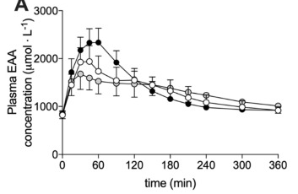
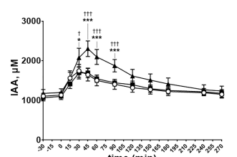
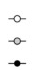
Is casein really the “slow protein”?
Micellar casein
Calcium caseinate
Sodium Caseinate
Sodium Caseinate
Calcium caseinate and micellar casein
Or is it the processing that affects the speed of digestion?
Tormmelen et al 2020; Boullier et al 2023

Slide 20

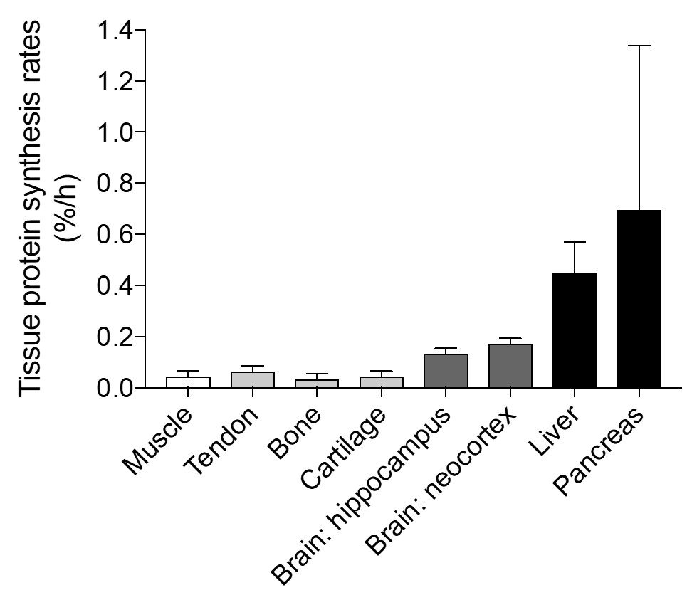
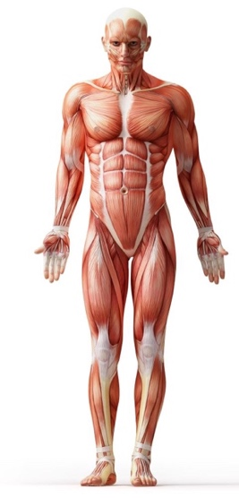
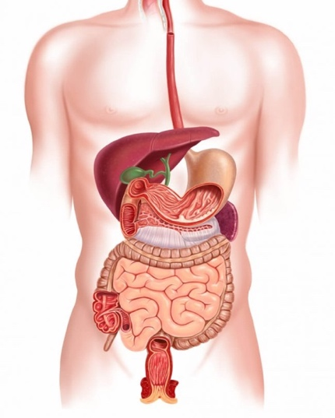
Beyond muscle … implications for medical nutrition?
.
Current Sport / Medical nutrition propositions are based on protein turn-over in muscle
Muscle tissue has a relatively low protein turnover comparing to other organs!
Trommelen et al 2021

Slide 21
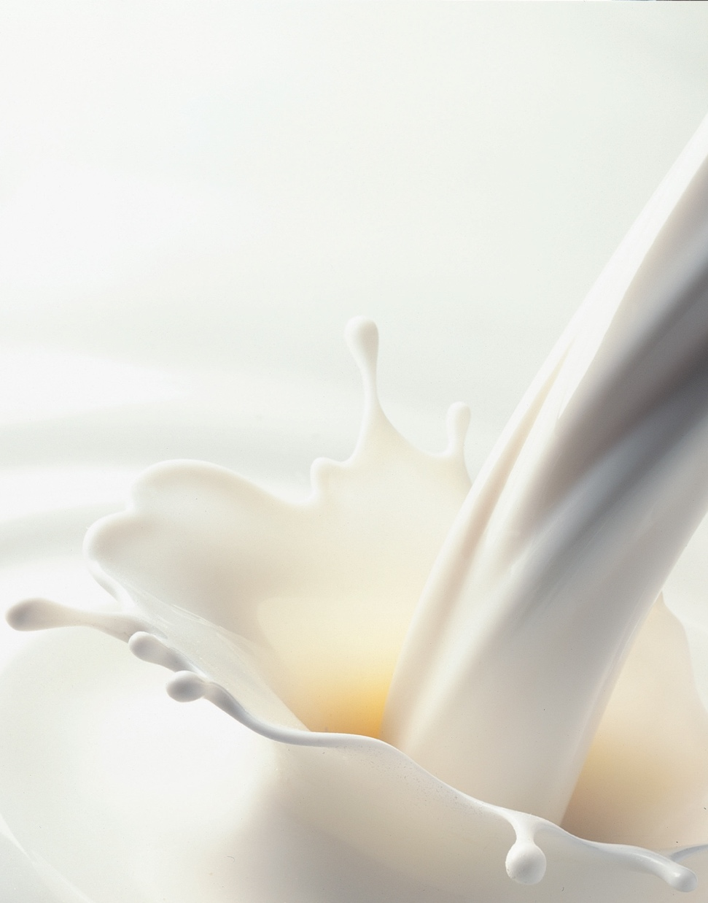
Conclusions
Milk:
Is the only thing in this world designed by nature to be our food
Is incredibly complex and adaptable
Is a rich source of ingredients we can use
components (ingredients) provide a lot of benefits beyond the nutrition
Through skilled processing milk benefits can be preserved and delivered to all age groups for various benefits
We are just at the beginning of our understanding of magic of milk

Slide 22
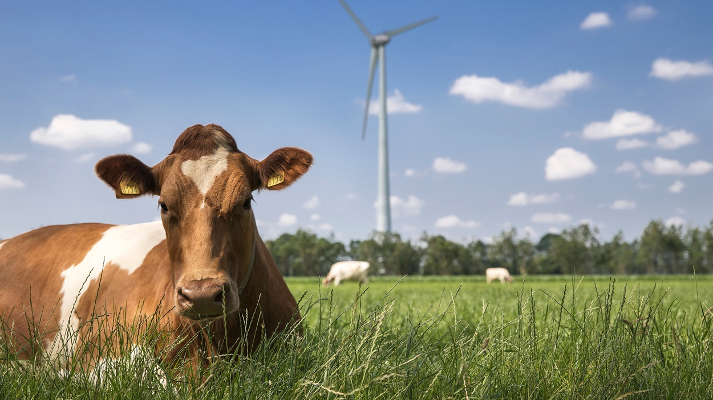
Thank youQuestions?
【谢谢大家
有问题吗？】

